Slide 1
Skin Cancer Detection using CNN and Transfer Learning
Snehal Pimple

Slide 2
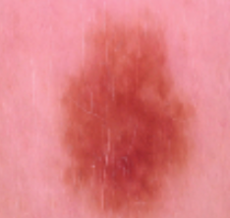
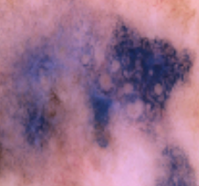
Dataset & Preprocessing
Dataset Distribution
BENIGN
BENIGN
MALIGNANT
32
224
32
1440
80%
2110
TRAIN
224
2637
Resize
Normalization
20%
MALIGNANT
32
527
VALIDATION
32
224
TEST
660
660
224
TOTAL = 3297
https://www.kaggle.com/fanconic/skin-cancer-malignant-vs-benign

Slide 3
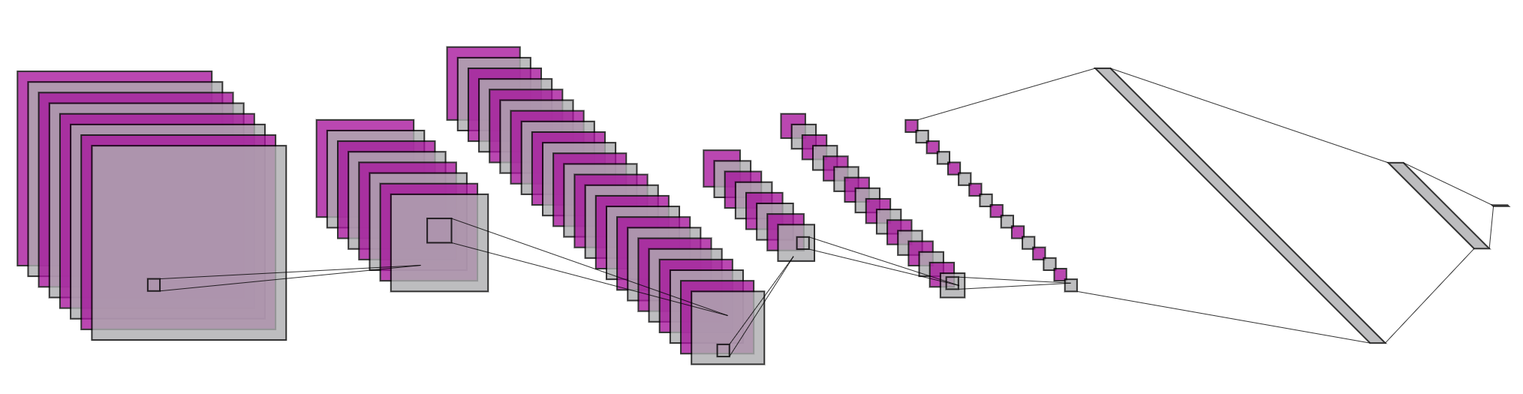
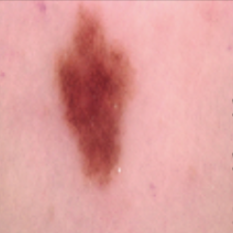
Convolutional Neural Network (CNN)
64@32x32
64@16x16
1x256
64@16x16
128@8x8
128@4x4
64@8x8
1x80
MALIGNANT
Max
Pooling
BENIGN
Max
Pooling
Conv2D
Max
Pooling
Conv2D
Conv2D
Batch Size = 16

Slide 4
Hyperparameter Selection – Number of layers
Exp. No. | Convolutional Layers | Dense Layers | Train Accuracy (%) | Val Accuracy (%) | Test Accuracy (%)
1 | Conv2D (32@3x3) Conv2D (32@3x3) | Dense (80) | 100 | - | 81.21
2 | Conv2D (32@3x3) Conv2D (32@3x3) | Dense (256) Dense (80) | 100 | - | 81.67
3 | Conv2D (32@3x3) Max Pooling (2x2) Conv2D (32@3x3) | Dense (256) Dense (80) | 93.26 | 74.2 | 82.27
Increasing the number of layers improved the accuracy.

Slide 5
Hyperparameter Selection – Number of Kernels
Exp. No. | Convolutional Layers | Dense Layers | Train Accuracy (%) | Val Accuracy (%) | Test Accuracy (%)
3 | Conv2D (32@3x3) Max Pooling (2x2) Conv2D (32@3x3) | Dense (256) Dense (80) | 93.26 | 74.2 | 82.27
4 | Conv2D (64@3x3) Max Pooling (2x2) Conv2D (64@3x3) | Dense (256) Dense (80) | 97.97 (epoch 26/100) | 78 | 83.03
5 | Conv2D (128@3x3) Max Pooling (2x2) Conv2D (128@3x3) | Dense (256) Dense (80) | 89.65 (epoch 19/100) | 76.60 | 82.12
Increasing the number of kernels improved the accuracy, however up to certain numbers.

Slide 6
Hyperparameter Selection – Kernel Size
Exp. No. | Convolutional Layers | Dense Layers | Train Accuracy (%) | Val Accuracy (%) | Test Accuracy (%)
4 | Conv2D (64@3x3) Max Pooling (2x2) Conv2D (64@3x3) | Dense (256) Dense (80) | 97.97 (epoch 26/100) | 78 | 83.03
6 | Conv2D (64@5x5) Max Pooling (2x2) Conv2D (64@5x5) | Dense (256) Dense (80) | 85.01 (epoch 22/100) | 71.48 | 81.39
Increasing the number of kernel size did not improve the accuracy

Slide 7
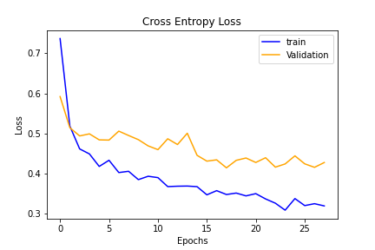
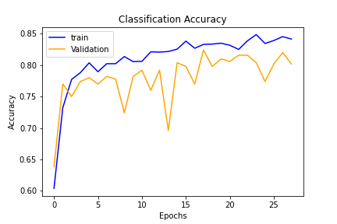
Final selected architecture
Exp. No. | Convolutional Layers | Dense Layers | Train Accuracy (%) | Val Accuracy (%) | Test Accuracy (%)
15 | Conv2D (64@3x3) Max Pooling (2x2) Dropout (0.5) Conv2D (64@3x3) Max Pooling (2x2) Dropout (0.5) Conv2D (128@3x3) Max Pooling (2x2) Dropout (0.5) | Dense (256) Dense (80) | 82.80 (epoch 26/100) | 79.40 | 84.70

Slide 8
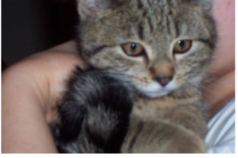
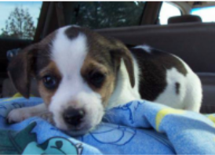
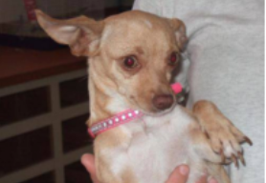
Transfer Learning
64@16x16
64@32x32
1x256
64@16x16
128@8x8
128@4x4
64@8x8
1x80
CAT
DOG
Max
Pooling
Max
Pooling
Conv2D
Max
Pooling
Conv2D
Conv2D
Transfer Knowledge
64@32x32
64@16x16
1x256
Frozen Weights
64@16x16
128@8x8
128@4x4
64@8x8
1x80
BENIGN
Max
Pooling
MALIGNANT
Max
Pooling
Conv2D
Max
Pooling
Conv2D
Conv2D

Slide 9
Transfer Learning Results
Exp. No. | Dataset | Convolutional Layers | Frozen Layers | Dense Layers | Train Accuracy (%) | Val Accuracy (%) | Test Accuracy (%)
16 | Cats vs Dogs | Conv2D (64@3x3) Max Pooling (2x2) Dropout (0.5) Conv2D (64@3x3) Max Pooling (2x2) Dropout (0.5) Conv2D (128@3x3) Max Pooling (2x2) Dropout (0.5) | None | Dense (256) Dense (80) | 83.48 (epoch 42/100) | 81.77 | 82.20
17 -19 | Benign vs Malignant with Transfer Learning | Conv2D (64@3x3) Max Pooling (2x2) Dropout (0.5) Conv2D (64@3x3) Max Pooling (2x2) Dropout (0.5) Conv2D (128@3x3) Max Pooling (2x2) Dropout (0.5) | All three Conv2D | Dense (256) Dense (80) | 79.12 (epoch 14/100) | 71 | 76.52
 |  |  | Initial two Conv2D |  | 83.14 (epoch 17/100 | 70.64 | 78.64
 |  |  | Initial first Conv2D |  | 84.75 (epoch 16/100 | 75 | 82.42

Slide 10
Conclusion
For skin cancer detection, CNN model achieved 84.70% accuracy on test data.
With Transfer Learning, CNN model achieved 82.42% accuracy.
Complex model does not necessarily give the highest accuracy; could lead to the overfitting problem
Approaches to boost accuracy
Increase sample size
Hyperparameter tuning
Data augmentation
Transfer learning

